Slide 1

Chapter 10：Switching DC Power Supplies
（开关电源）
10-1 Introduction
10-2 Linear Power supplies
10-3 Overview of Switching Power Supplies
10-4 dc-dc Converters with Electrical
Isolation

Slide 2
本章知识点：
掌握5种DC/DC变换器的工作原理和性能，即
Flyback DC/DC变换器
Forward DC/DC变换器
Full-Bridge DC/DC变换器
Half-Bridge DC/DC变换器
Push-Pull DC/DC变换器

Slide 3
10-1 Introduction
Regulated dc power supplies are needed for most analog and digital electronic systems.
1 The requirements for most power supplies are:
Regulated output: The output voltage must be held constant within a specified tolerance when the input voltage and the output load changes.
DC
regulated
DC
unregulated
DC-DC converter
Load
Load

Slide 4
Galvanic isolation（电隔离）: between the input and the outputs, and/or among the multiple outputs, to meet safety requirements.
High conversion ratios: to minimize the current and voltage stresses
Obtain multiple outputs :
Smaller size, lower weight, higher efficiency
DC
regulated
DC
unregulated
DC-DC converter
Load
Load

Slide 5
2 Review of basic Magnetic Circuit Concepts
(in Chapter 3)
Terms
F----magnetomotive force (磁势、磁动势)
H----magnetic field intensity (磁场强度 A/m)
B----flux density (磁通密度 \ 磁感应强度 Wb/m² or Tesla)
Φ----flux (磁通)
λ_{m}----flux linkage (磁链)
R_{m} ----reluctance (磁阻)
μ----permeability (磁导率 H/m)
Saturation(饱和)

Slide 6
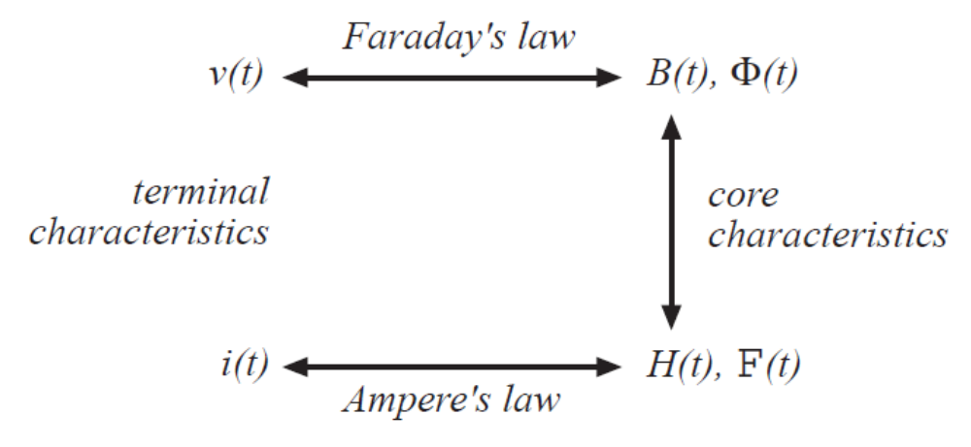
Basic relations
B----flux density (磁通密度 Wb/m² or Tesla)
Φ----flux (磁通)
F----magnetomotive force (磁势、磁动势 A)
H----magnetic field intensity (磁场强度 A/m)

Slide 7
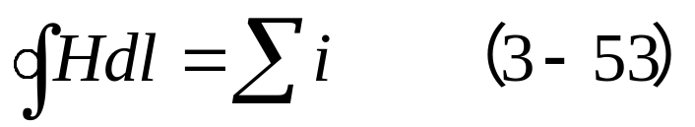
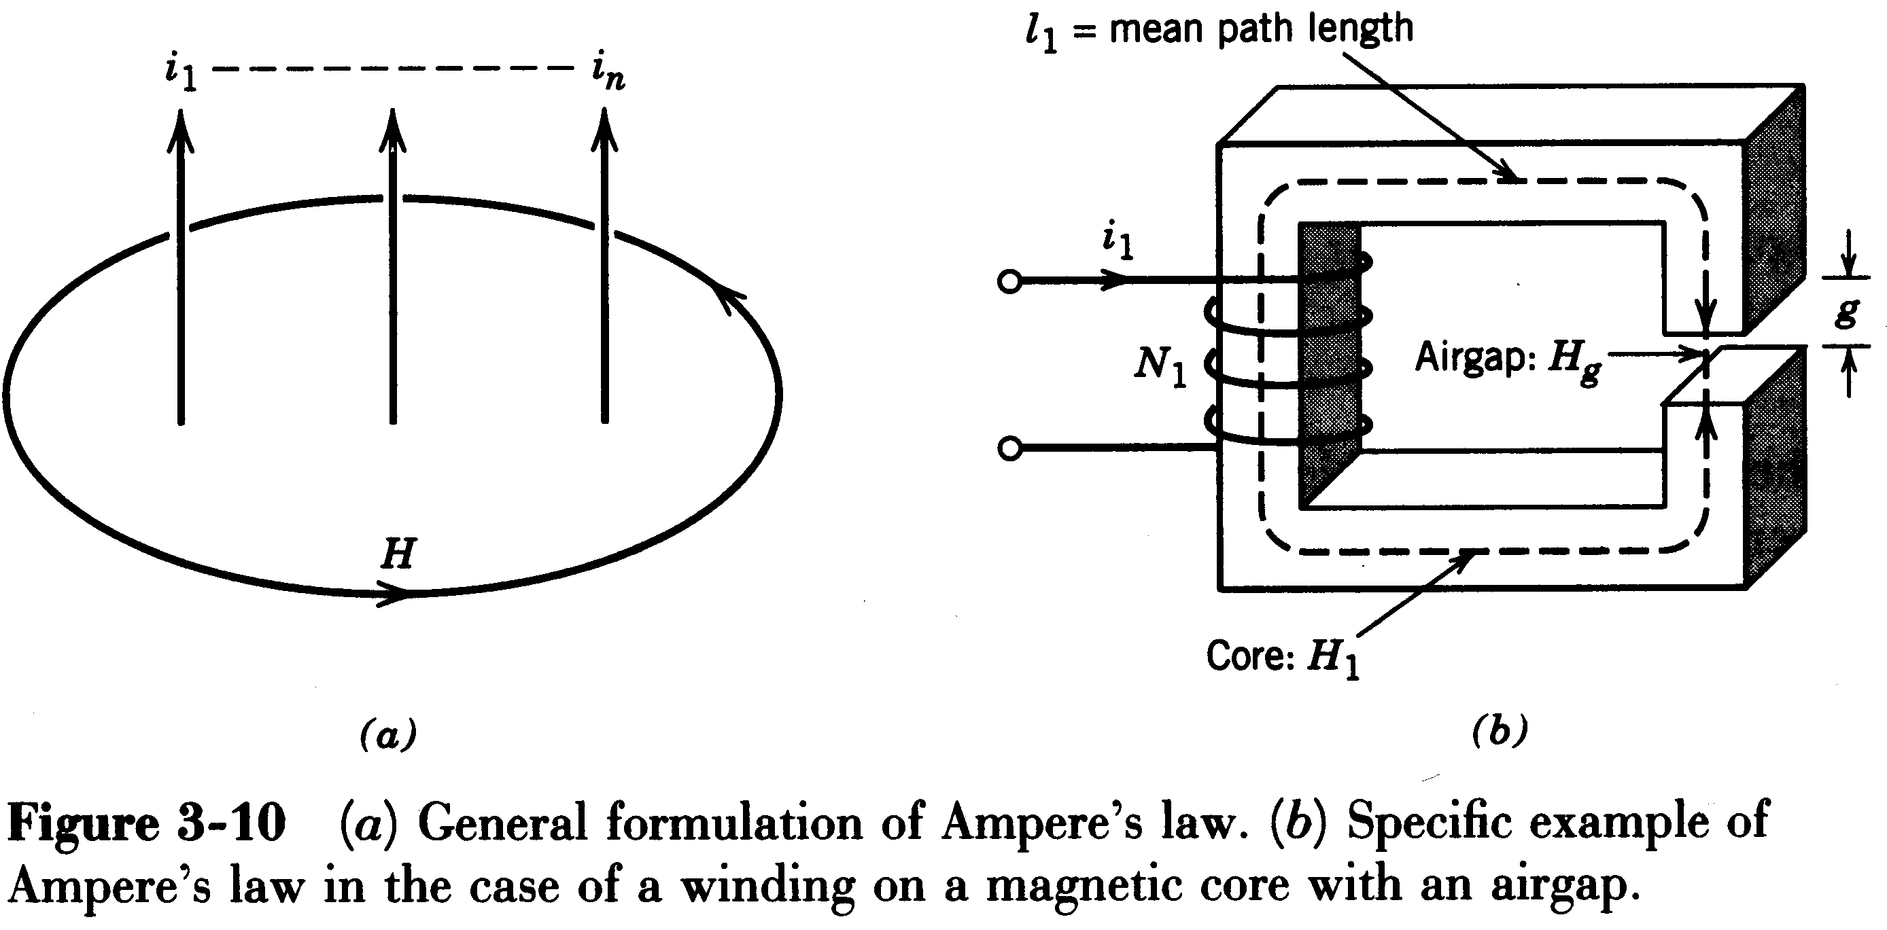
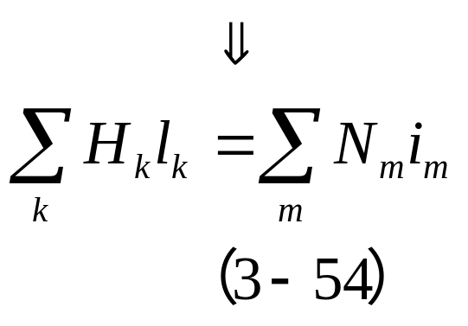
（1） Ampere’s Law
The line integral of the magnetic field intensity H（磁场强度）equals the total (enclosed) current:
For most practical circuits,

Slide 8
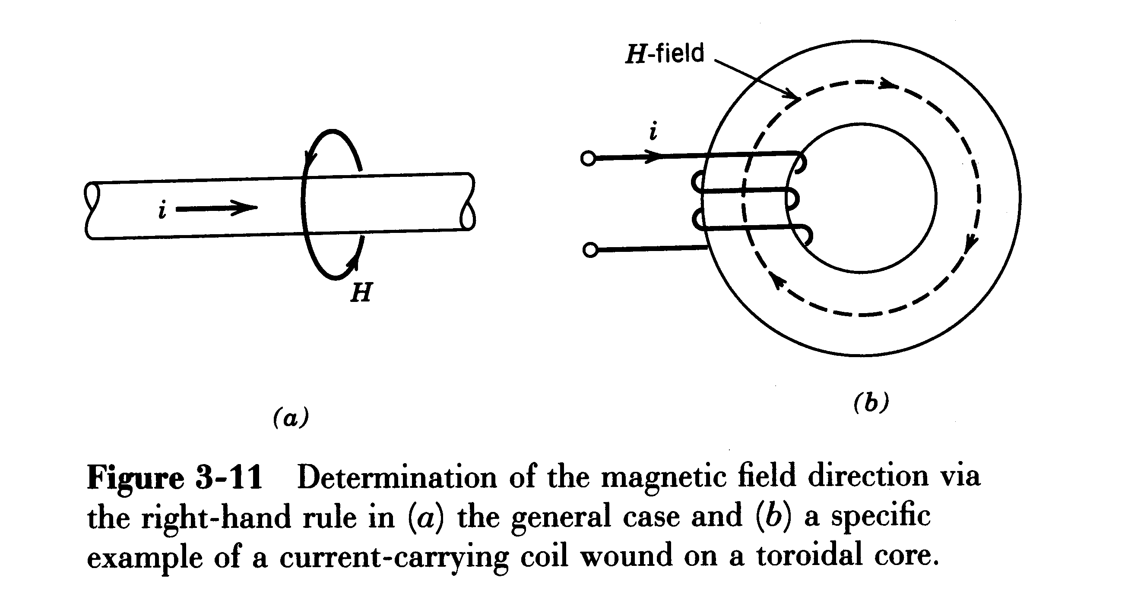
Direction of Magnetic Field (right hand rule) （右手定则）

Slide 9
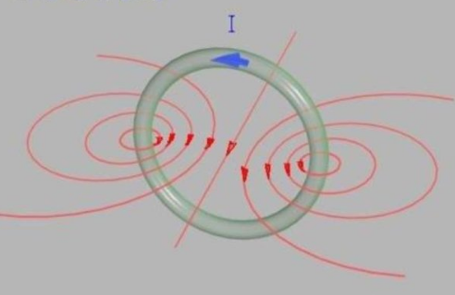

Slide 10
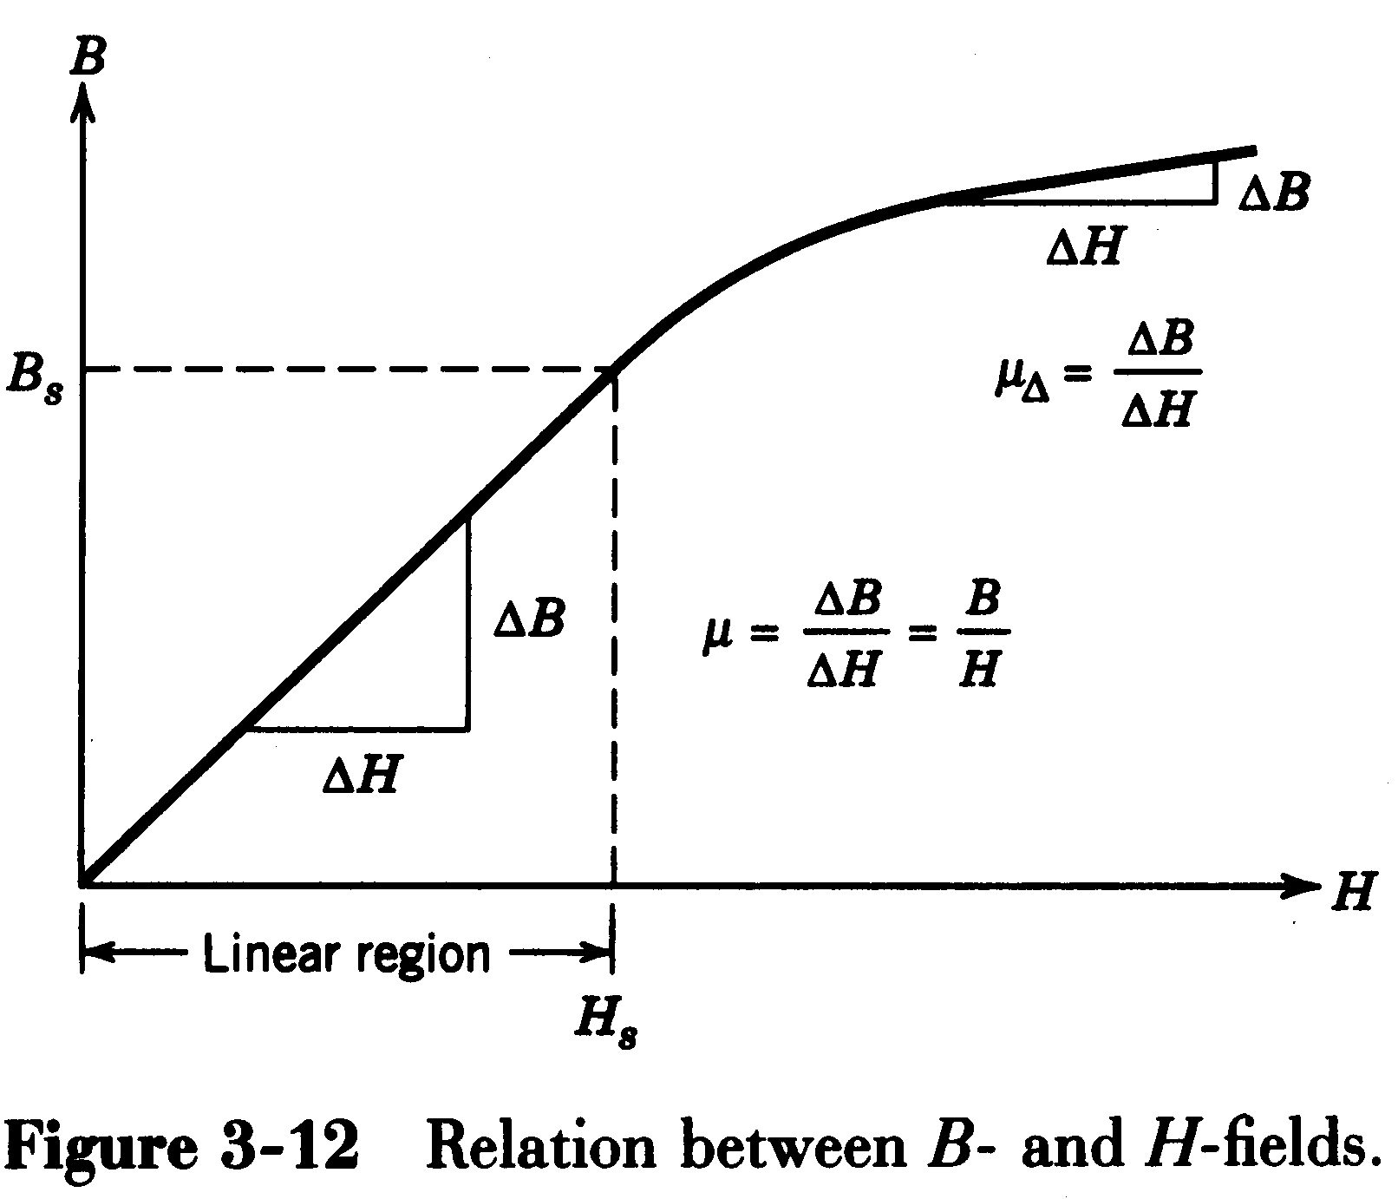
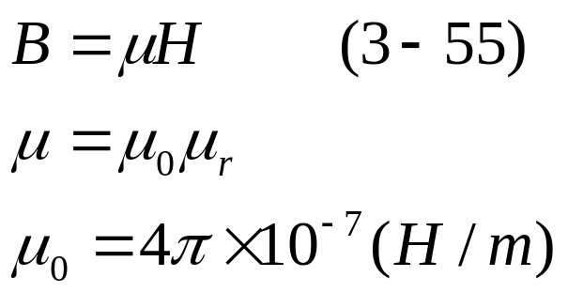
B-H Relationship; Saturation
µ₀—air permeability
（空气磁导率）
µ_{r}—relative permeability
（相对磁导率）

Slide 11
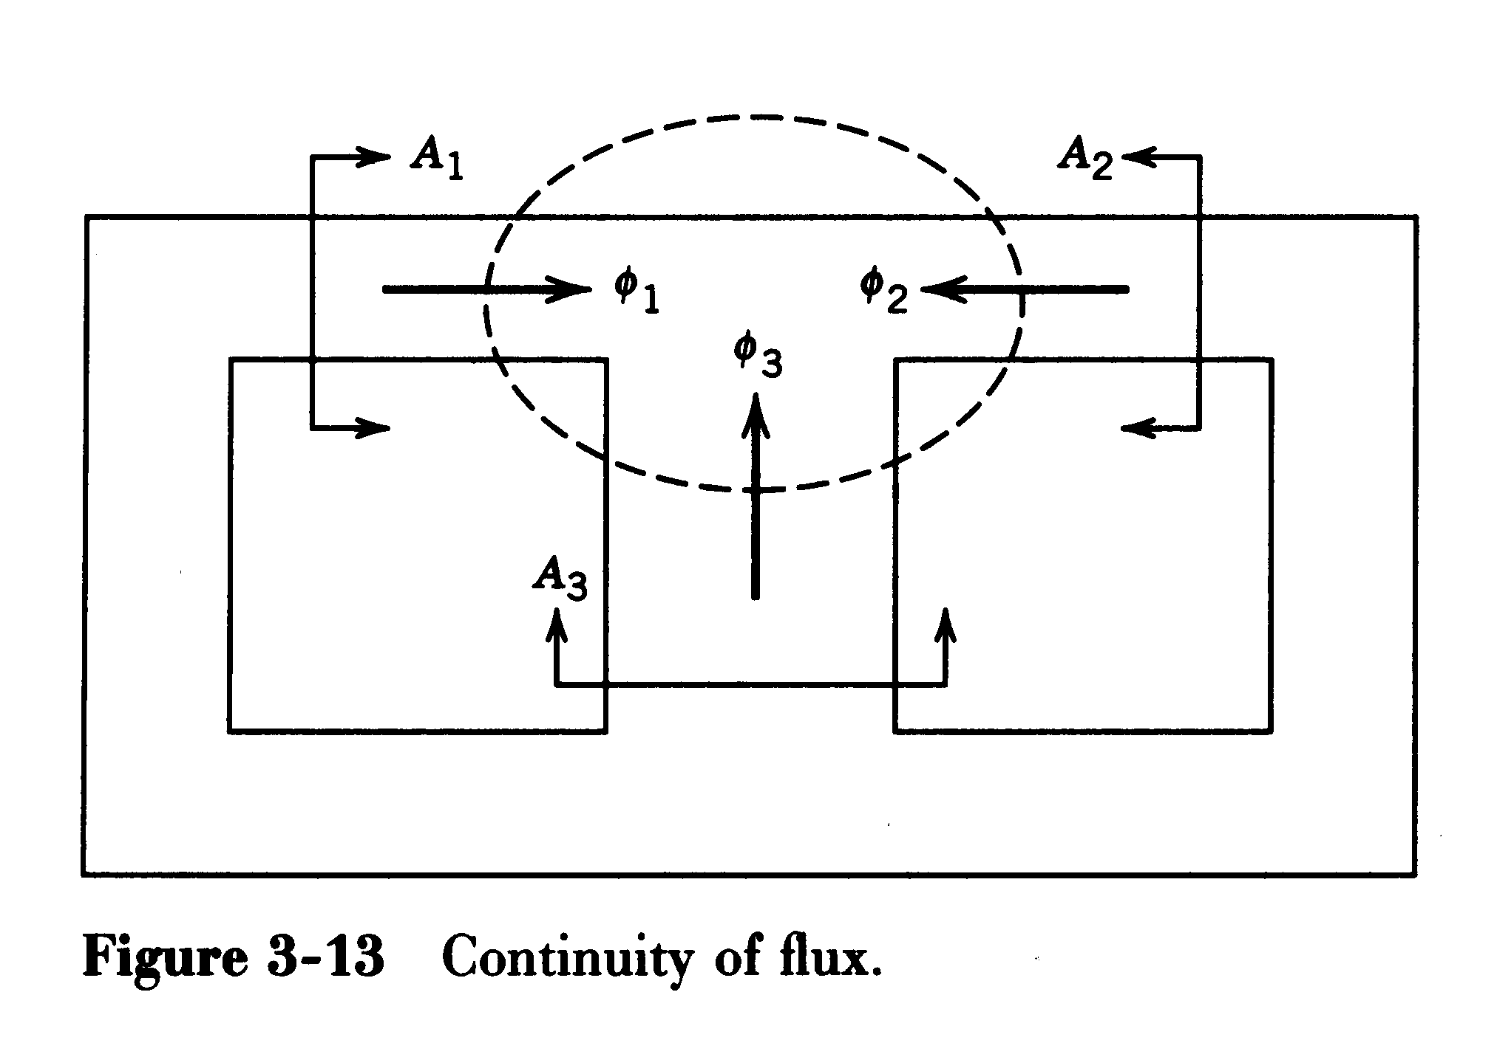
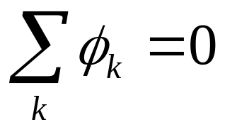
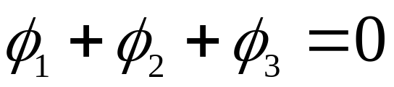
（2） Continuity of Flux Lines
The flux lines entering a closed surface area must equal those leaving it.

Slide 12
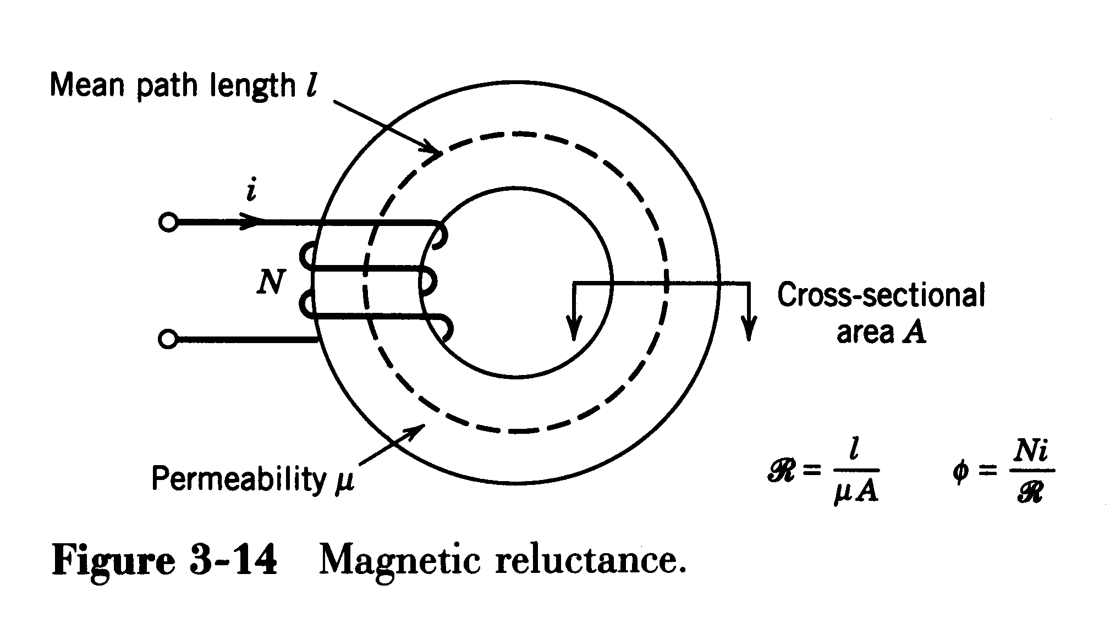
（3） Concept of Magnetic Reluctance（磁阻）
Flux is related to ampere-turns by reluctance

Slide 13
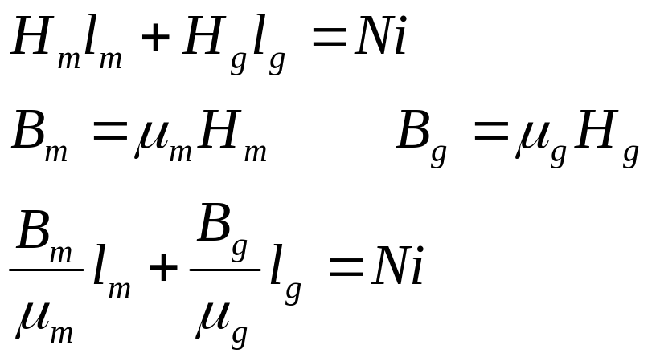
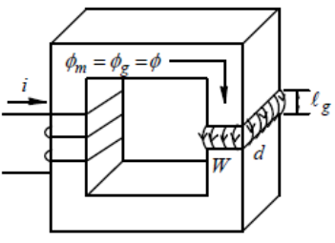
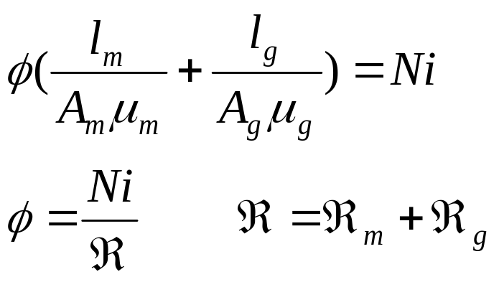
Magnetic circuits relationships:

Slide 14
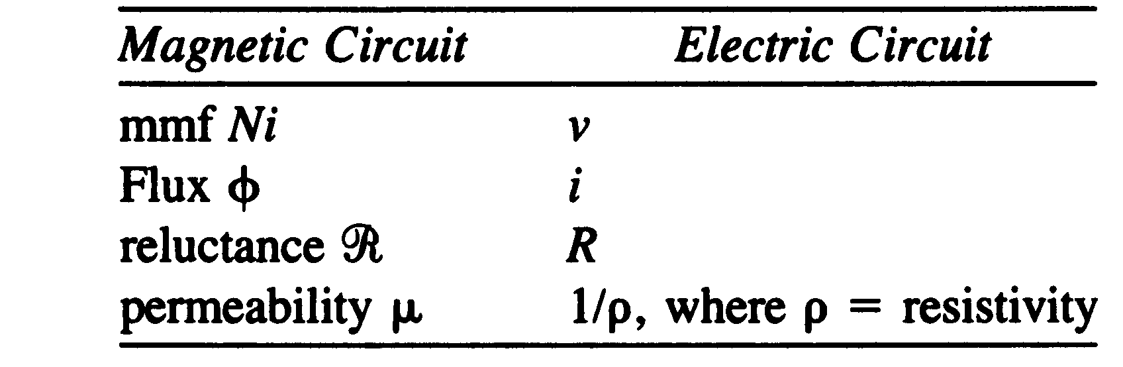
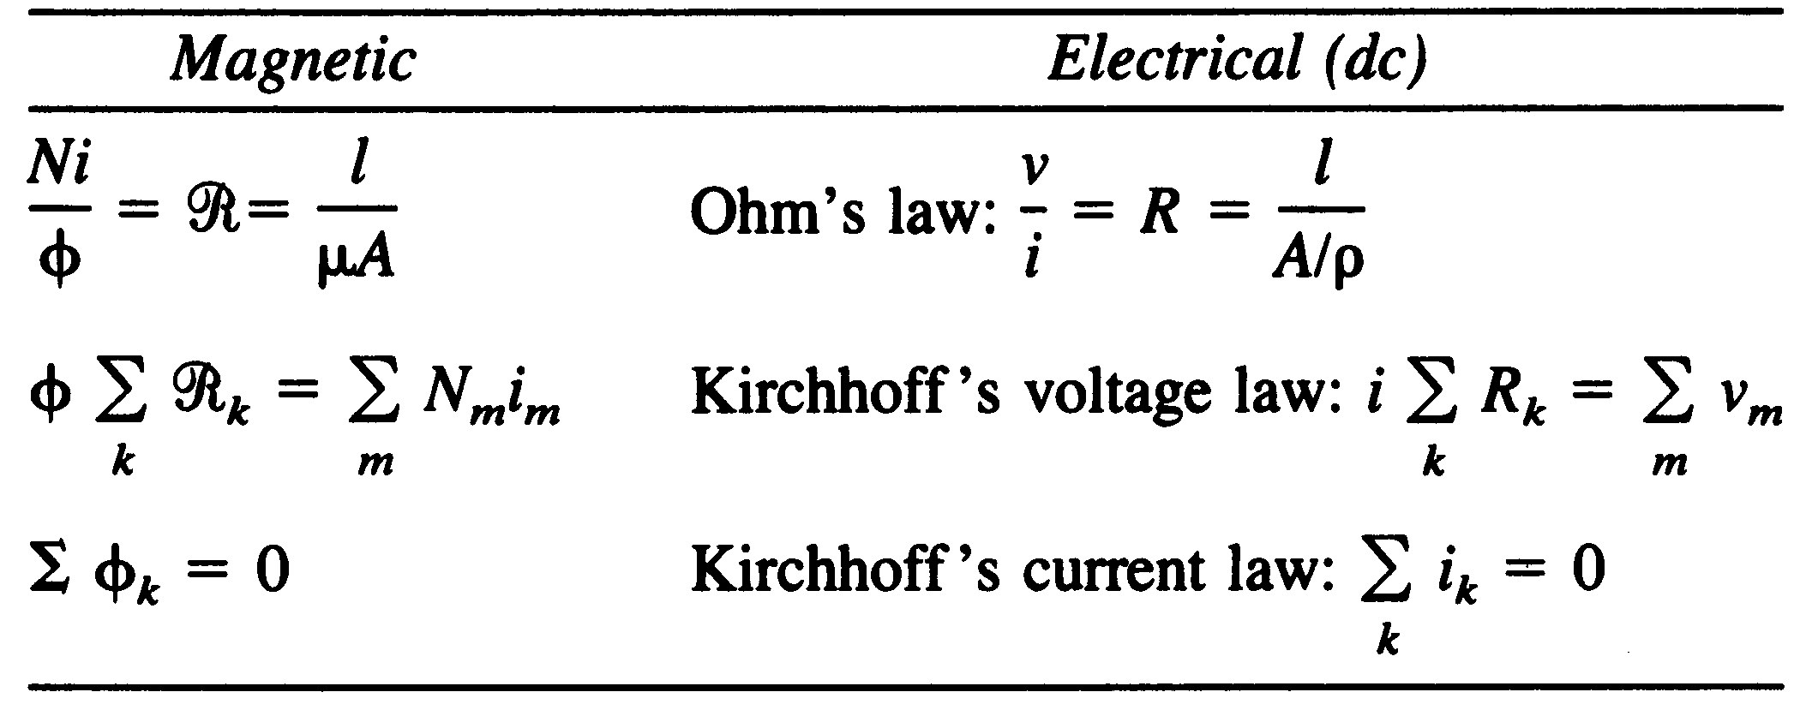
Table 3-2Analogy between Electrical and Magnetic Variables
Table 3-3 Analogy between Equations in Electrical and Magnetic Circuits

Slide 15
Basics of magnetic materials
Comparison
Electric Circuit
Magnetic Circuit
i₂
i₁
Φ₁
R₂
R₁
i₄
I
R₃
Φ₂
R₄
F
E
Φ₄

Slide 16
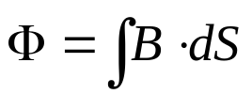
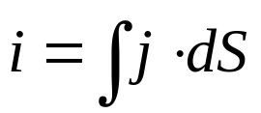
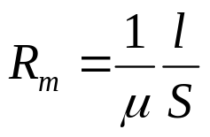
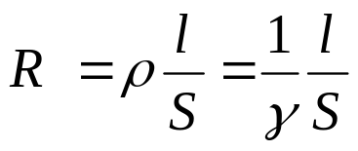


Basics of magnetic materials
Magnetic Circuit
1. Magnetomotive F
F = N • I
(1)
Φ₁
2. Magnetic Flux Φ
I
(2)
Φ₂
F
3. Magnetic Reluctance R_{m}
Φ₄
(3)
4. Magnetic Voltage U_{m}
(4)
H (磁场强度 A/m)
B (磁通密度)

Slide 17



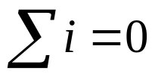

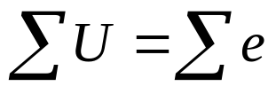
Basics of magnetic materials
5. Ohm’s law in magnetic circuit
Magnetic Circuit
(5)
By: Uniformity
Φ₁
6. Kirchhoff first law in magnetic
circuit
I
Φ₂
(6)
F
Φ₄
By: Continuity of flux
7. Kirchhoff second law in magnetic
circuit
(7)
By: Ampere’s law

Slide 18
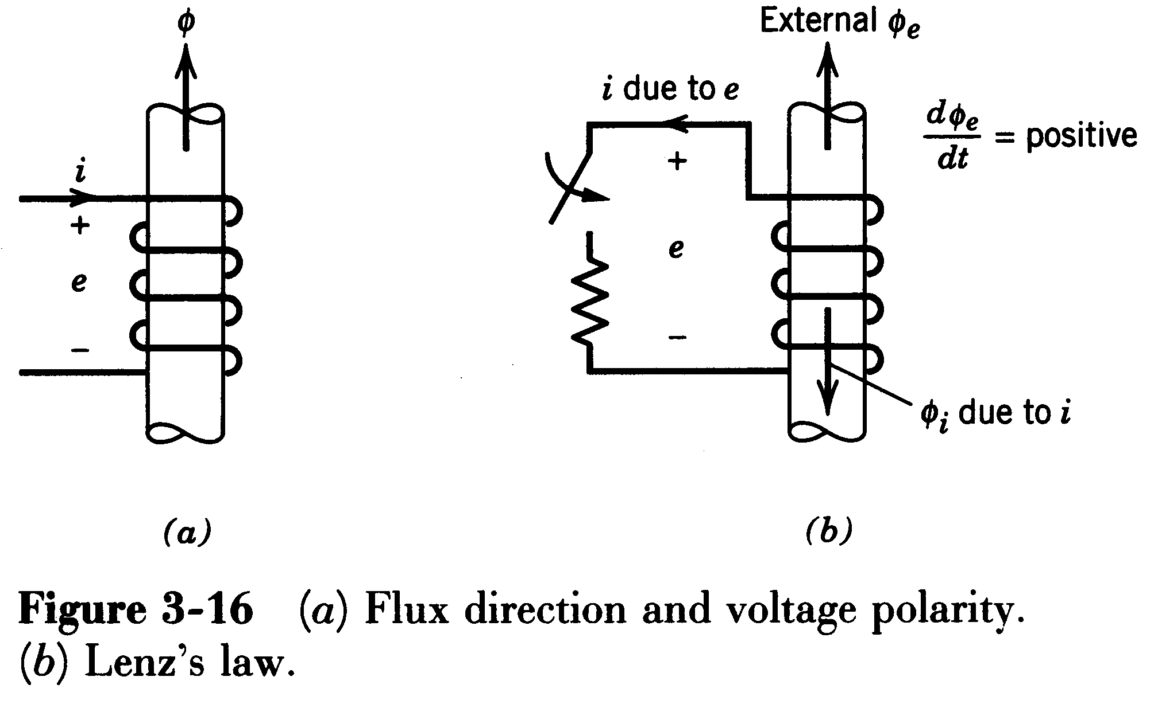
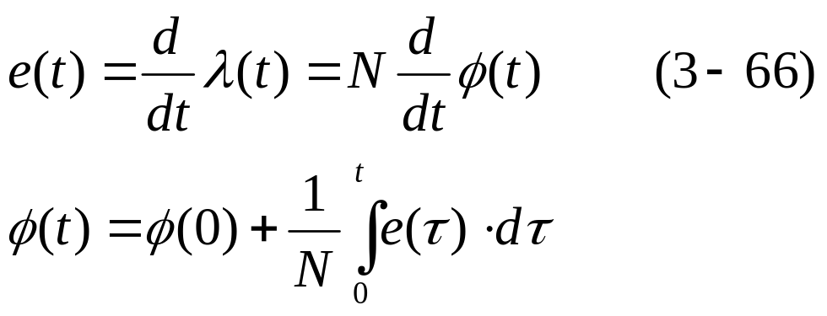
（4） Faraday’s Voltage Induction Law
Induced Voltage in a coil due to time-rate of change of flux linkage（磁链）

Slide 19
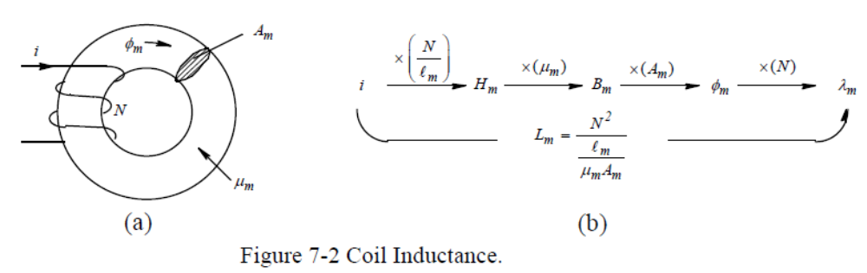
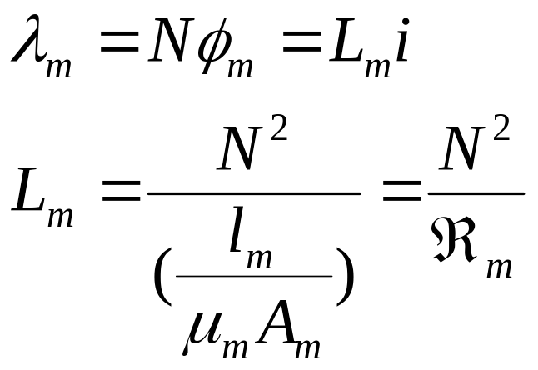
（5） Inductance L
Inductance relates flux-linkage to current and is a property of the magnetic circuit

Slide 20
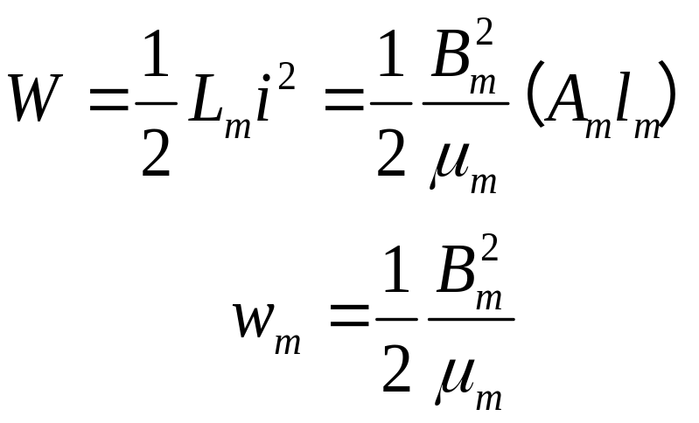
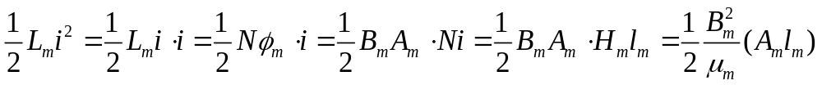
Energy Storage due to Magnetic Fields
Energy
Energy density
Energy in an inductor is stored in its magnetic field.

Slide 21
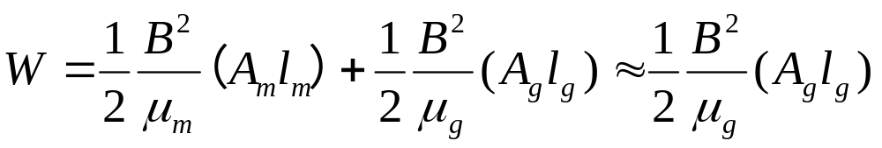
☆ In inductors, the energy is primarily stored in the air gap purposely introduced in the path of flux lines.
能量主要在气隙磁场中
In transformers, there is no air gap in the path of flux lines. Therefore, the energy stored in the core of an ideal transformer is zero.

Slide 22
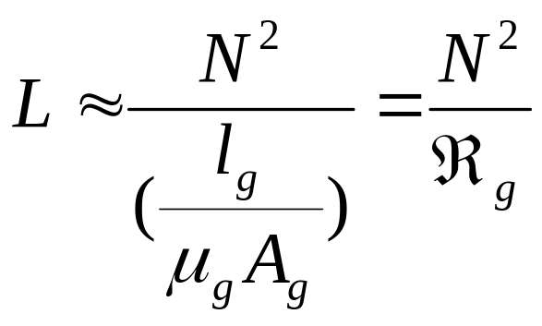
Question1: Why air gap is deeded for most inductors?
Question2: Which place has higher magnetic field strength, in the magnetic core, or the air gap?
Question3: Which parameters decide inductance?

Slide 23
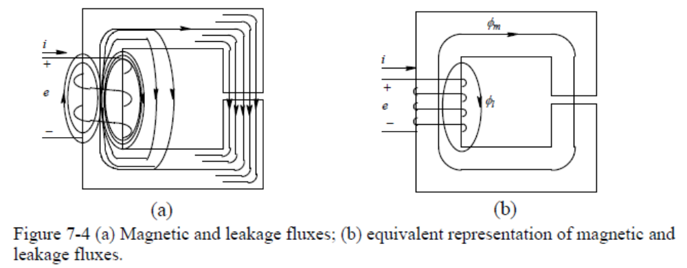
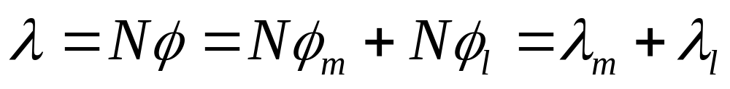
（6 ）TRANSFORMERS
Leakage and Magnetizing Inductances
（漏感和激磁电感）
The total flux linkage of the coil is:

Slide 24
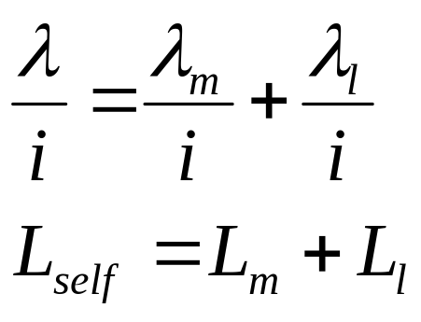
The total inductance (called the self-inductance) is:
L_{m}----magnetizing inductance（激磁电感）
L_{l}---leakage inductance（漏电感）

Slide 25
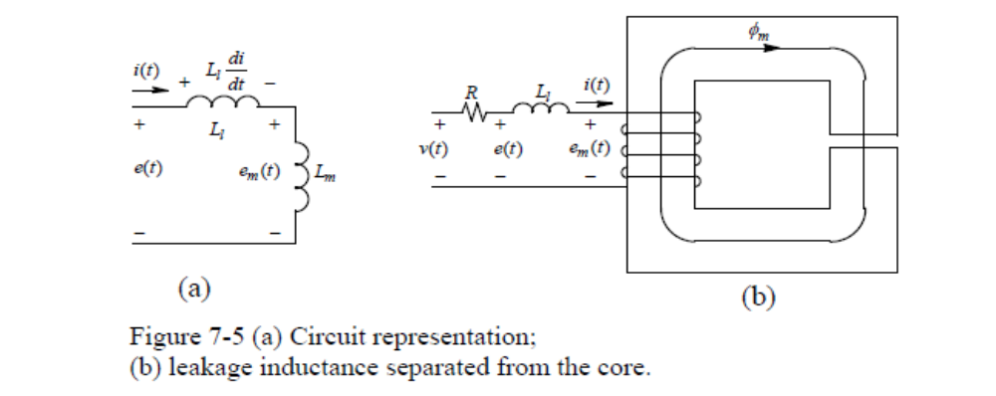
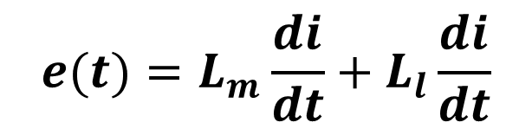

Slide 26
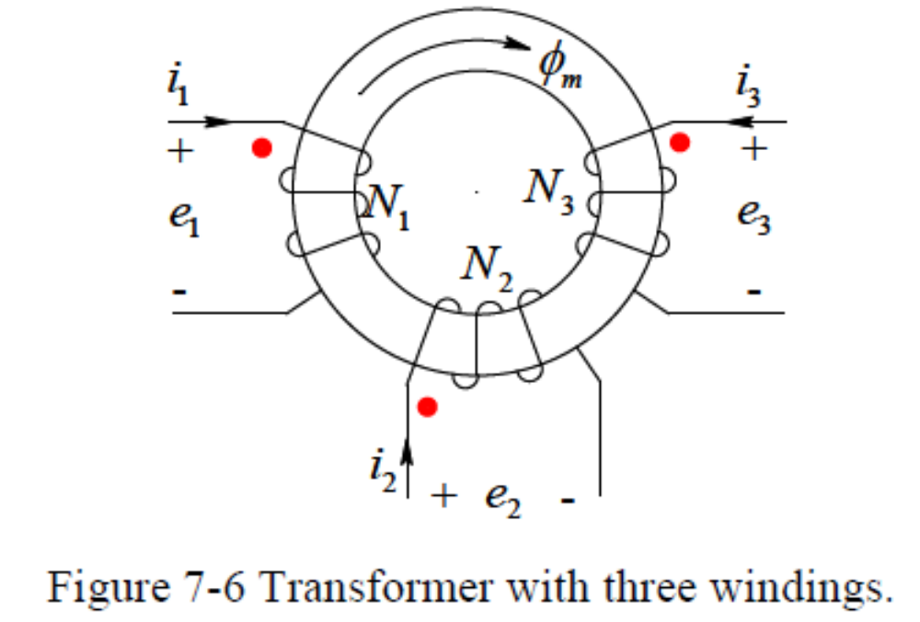
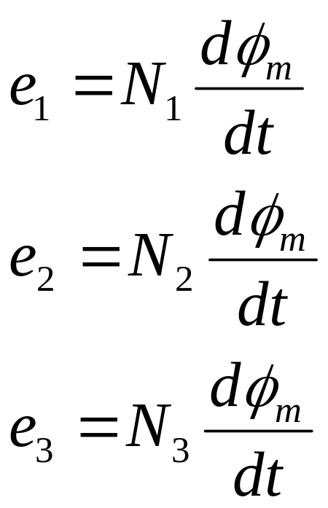
Faraday’s Law:

Slide 27
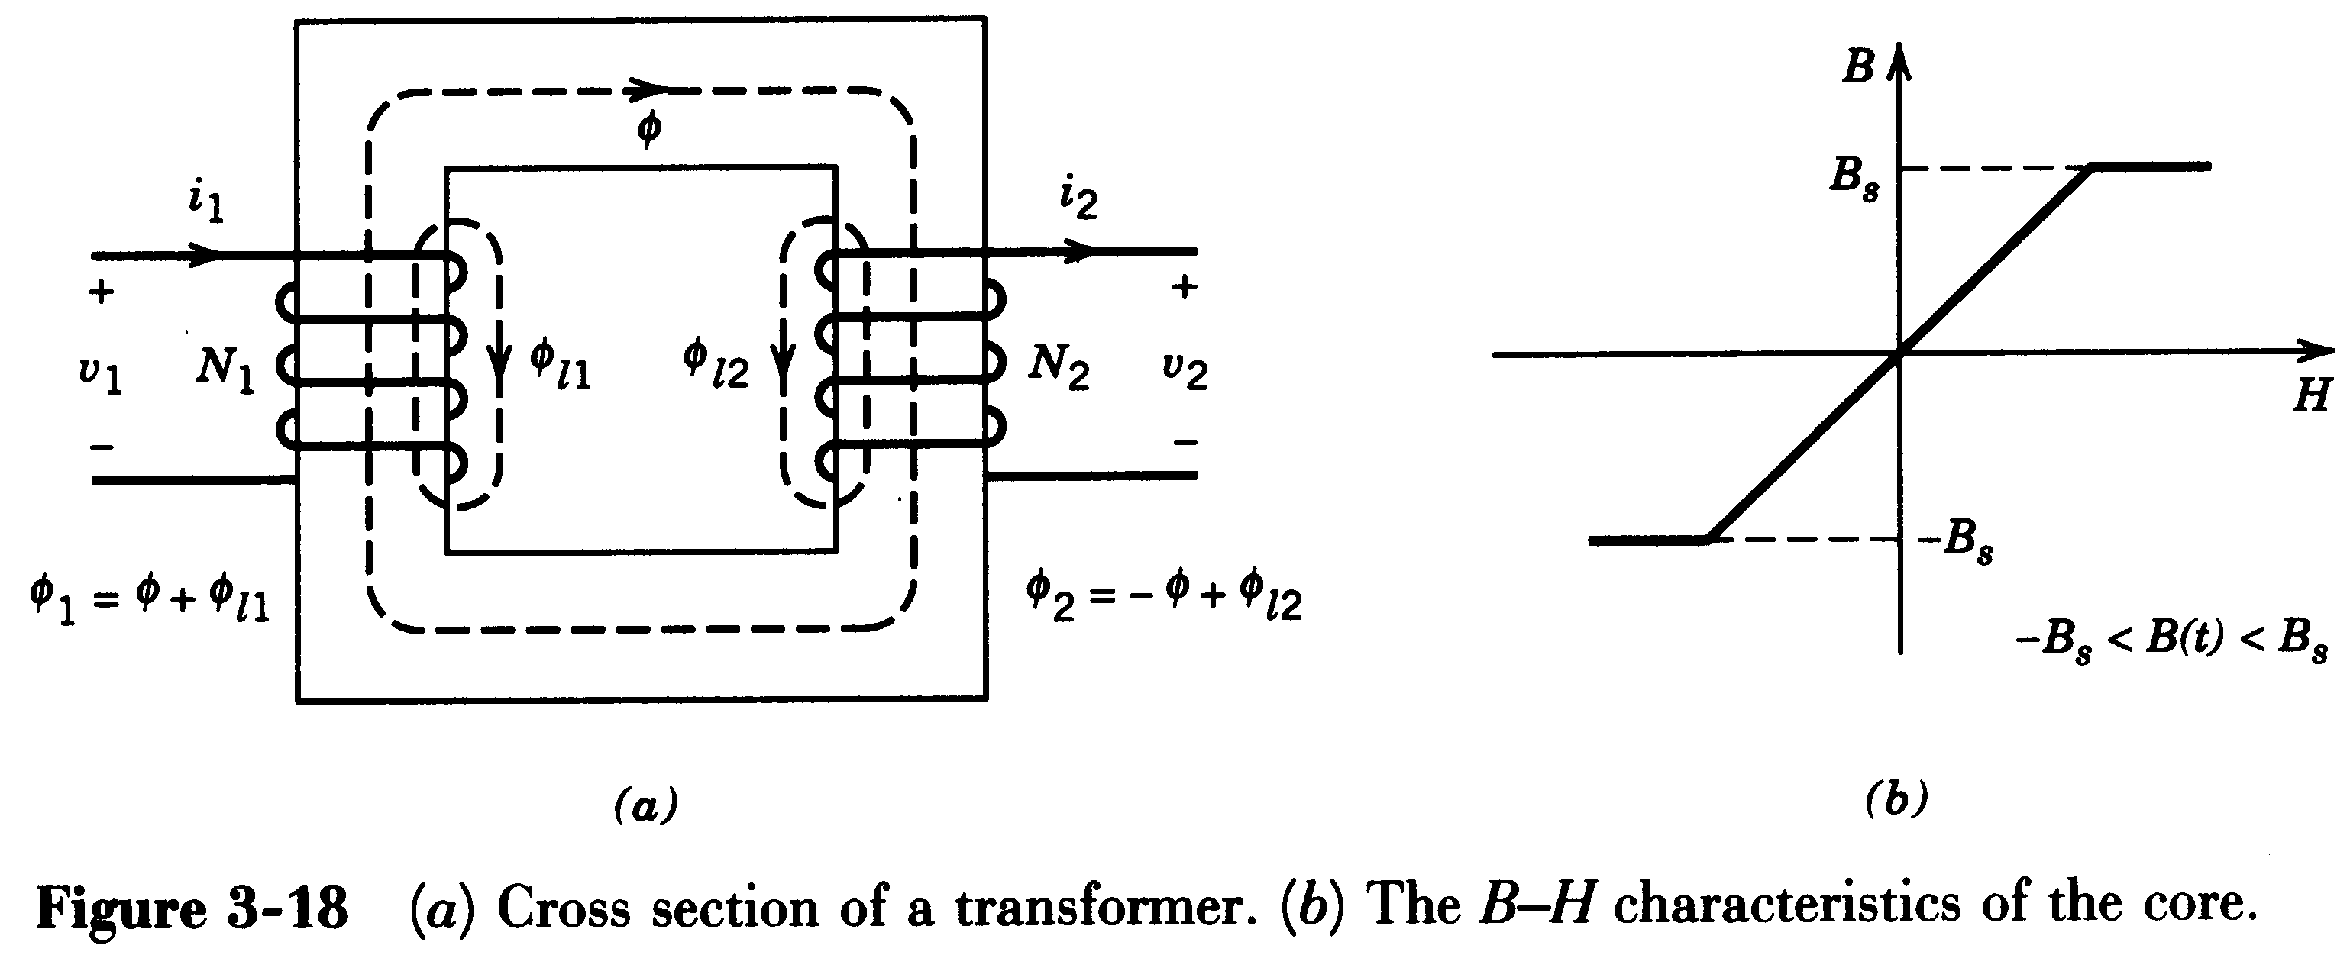
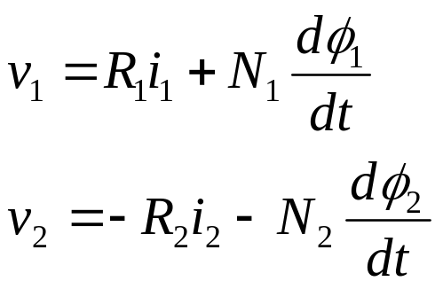
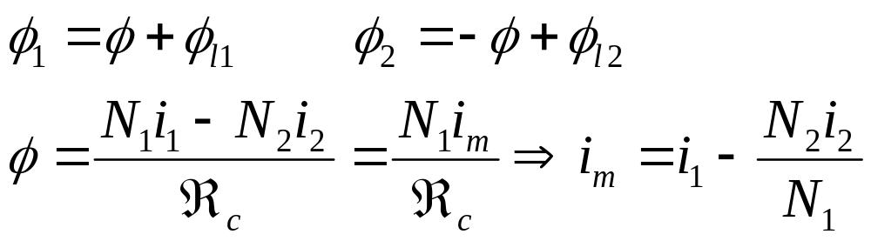
Analysis of a Transformer

Slide 28
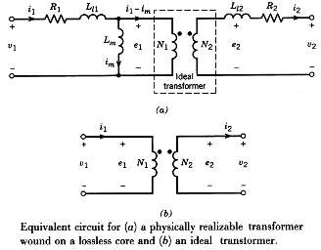
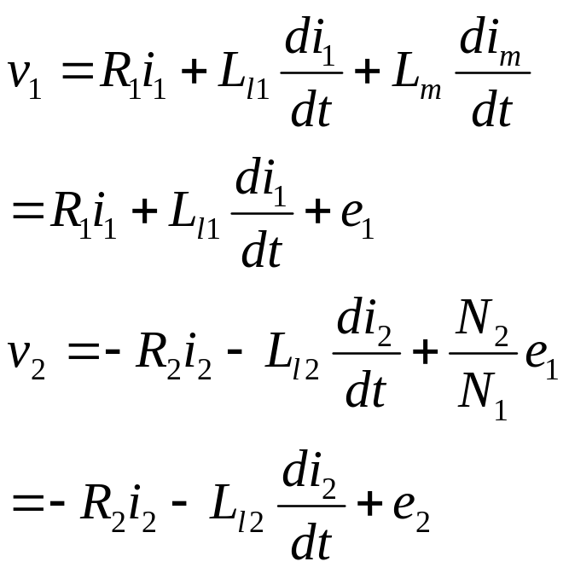
Transformer Equivalent Circuit
(Details see Chapter 3)

Slide 29
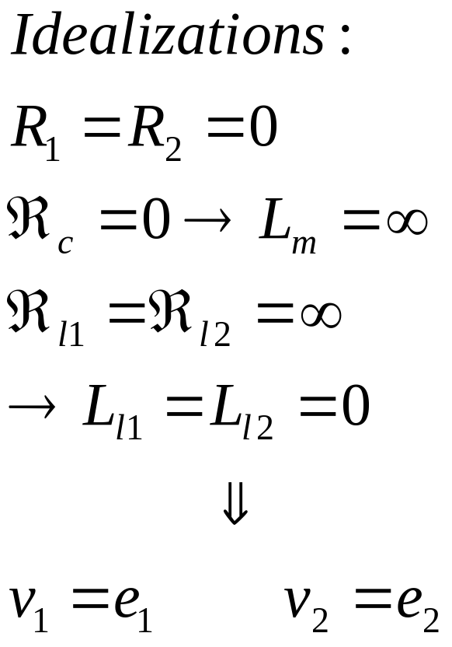
Ideal Transformers ☆

Slide 30
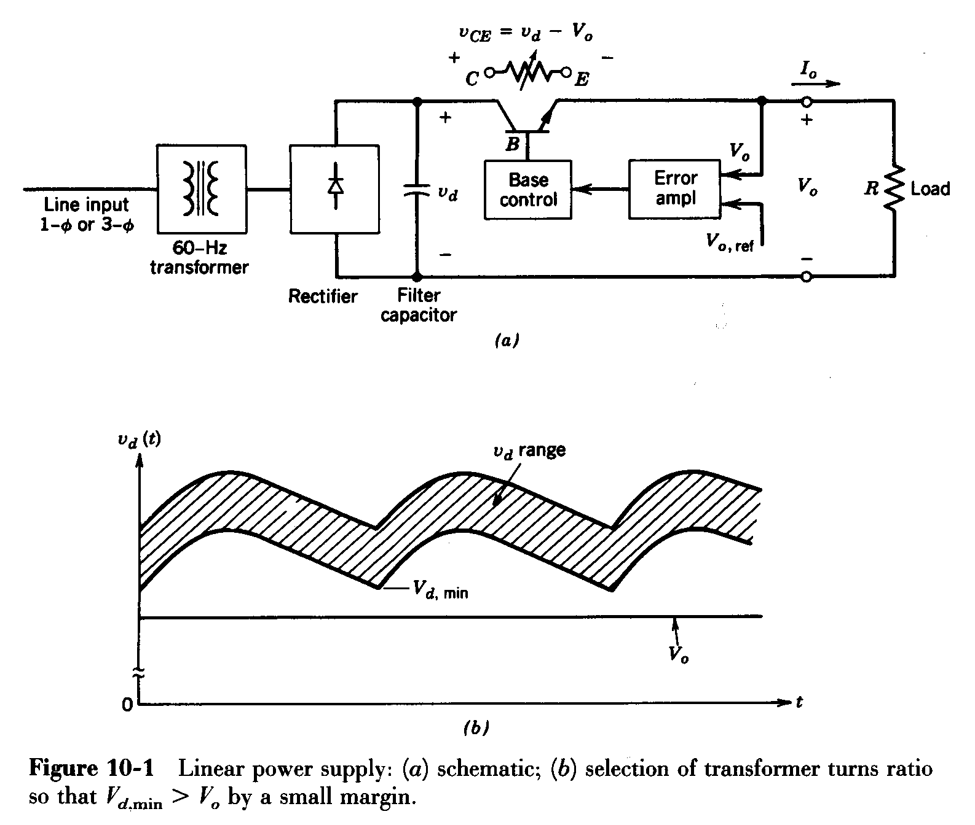
10-2 Linear Power Supplies 线性电源
(v_{d}-v_{o}) appears across the transistors and cause power losses.
A line frequency transformer is needed.
V_{dmin}>V_{o}

Slide 31
Two major shortcomings of linear power supplies（线性电源的两个主要缺点）:
A line-frequency transformer is required to provide electrical isolation between the input and the output. Such transformers are larger in size and weight compared to high-frequency transformers.
the transistor operates in its active region, incurring a significant amount of power loss.
The advantages of linear power supplies:
simple and may be cost less in small power ratings (<25W)
do not produce large EMI (Electro Magnetic Interference电磁干扰) with other equipment.

Slide 32
10-3 Overview of Switching Power Supplies
The ac input voltage is rectifier into an unregulated dc voltage by means of diode rectifier.
Line frequency AC input
Filter
Rectifier
EMI Filter
dc
unregulated
AC High
frequency
High
frequency
dc
regulated
Inverter
Transformer
AC
Rectifier
Filter
Isolation
Indirect DC to DC converter

Slide 33
EMI filter is used to prevent the conducted EMI.
Line frequency AC input
Filter
Rectifier
EMI Filter
dc
unregulated
AC High
frequency
High
frequency
dc
regulated
Inverter
Transformer
AC
Rectifier
Filter
Isolation
Indirect DC to DC converter
The dc-dc converter converts the input dc voltage v_{d} from one level to another dc level v_{o}.

Slide 34
Line frequency AC input
Filter
Rectifier
EMI Filter
dc
unregulated
AC High
frequency
High
frequency
dc
regulated
Inverter
Transformer
AC
Rectifier
Filter
Isolation
Indirect DC to DC converter
Inverter part: Power MOSFETs, IGBTs, operating in switching-mode with lower power losses.
Rectifier part: Fast recovery diodes, Schottky diodes, Synchronous rectifiers

Slide 35
Feed back
V_{o1}
regulated
dc
unregulated
Inverter
Rectifier
+
Filter
In many applications, multi outputs are required.
V_{o2}
unregulated
Rectifier
+
Filter
V_{o3}
unregulated
Multiple outputs
Rectifier
+
Filter
Only one output V_{o1} is regulated and the other two are unregulated. If V_{o2} and V_{o3} needs to be regulated, then linear regulator can be used to regulate them.

Slide 36
Two major advantages of switching power supplies:
higher energy efficiency and larger power-handing capability: the switching elements operate as a switch: either completely off or completely on. Therefore, reduce power losses.
smaller size and weight: Since a high-frequency isolation transformer is used.
The shortcomings of switching power supplies:
more complex.
proper measures must be taken to prevent EMI due to high-frequency switchings.

Slide 37
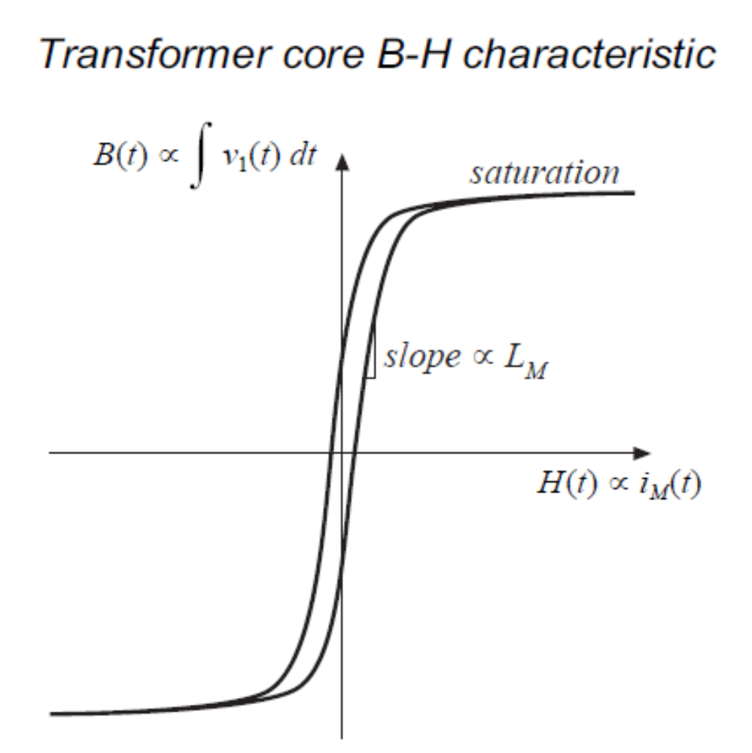
10-4 dc-dc converters with electrical isolation
10-4-1 Introduction
A typical transformer core characteristic in terms of its B-H (hysteresis磁滞) loop.
Quardant 1
Quardant 3

Slide 38
Various types of dc-dc converters (with isolation) can be divided into two basic categories, based on the way they utilize the
transformer core:
Unidirectional core excitation where only the positive part (quadrant 1) of B-H loop is used.
Quardant 1
Bidirectional core excitation where both the positive (quadrant 1) and the negative (quadrant 3) parts of B-H loop are utilized alternatively.
Quardant 3

Slide 39
Unidirectional core excitation :
Flyback converter（单端反激式变换器） (derived from buck-boost converter).
Forward converter（单端正激式变换器） (derived from step-down converter).
Bidirectional core excitation :
Push-pull converter（推挽式变换器） (derived from step-down converter).
Half bridge converter（半桥式变换器） (derived from step-down converter).
Full bridge converter（全桥式变换器） (derived from step-down converter).

Slide 40
In this chapter, we will examine the above 5 kinds of dc-dc converters with isolation. All analyses are based on the following assumption:
The circuit elements are ideal
The converter operating in a steady-state
The converter operating in the continuous-
conduction mode
Leakage inductance should be considered for switch selection and snubber design. However, it has minor effect on the converter voltage transfer characteristics.

Slide 41
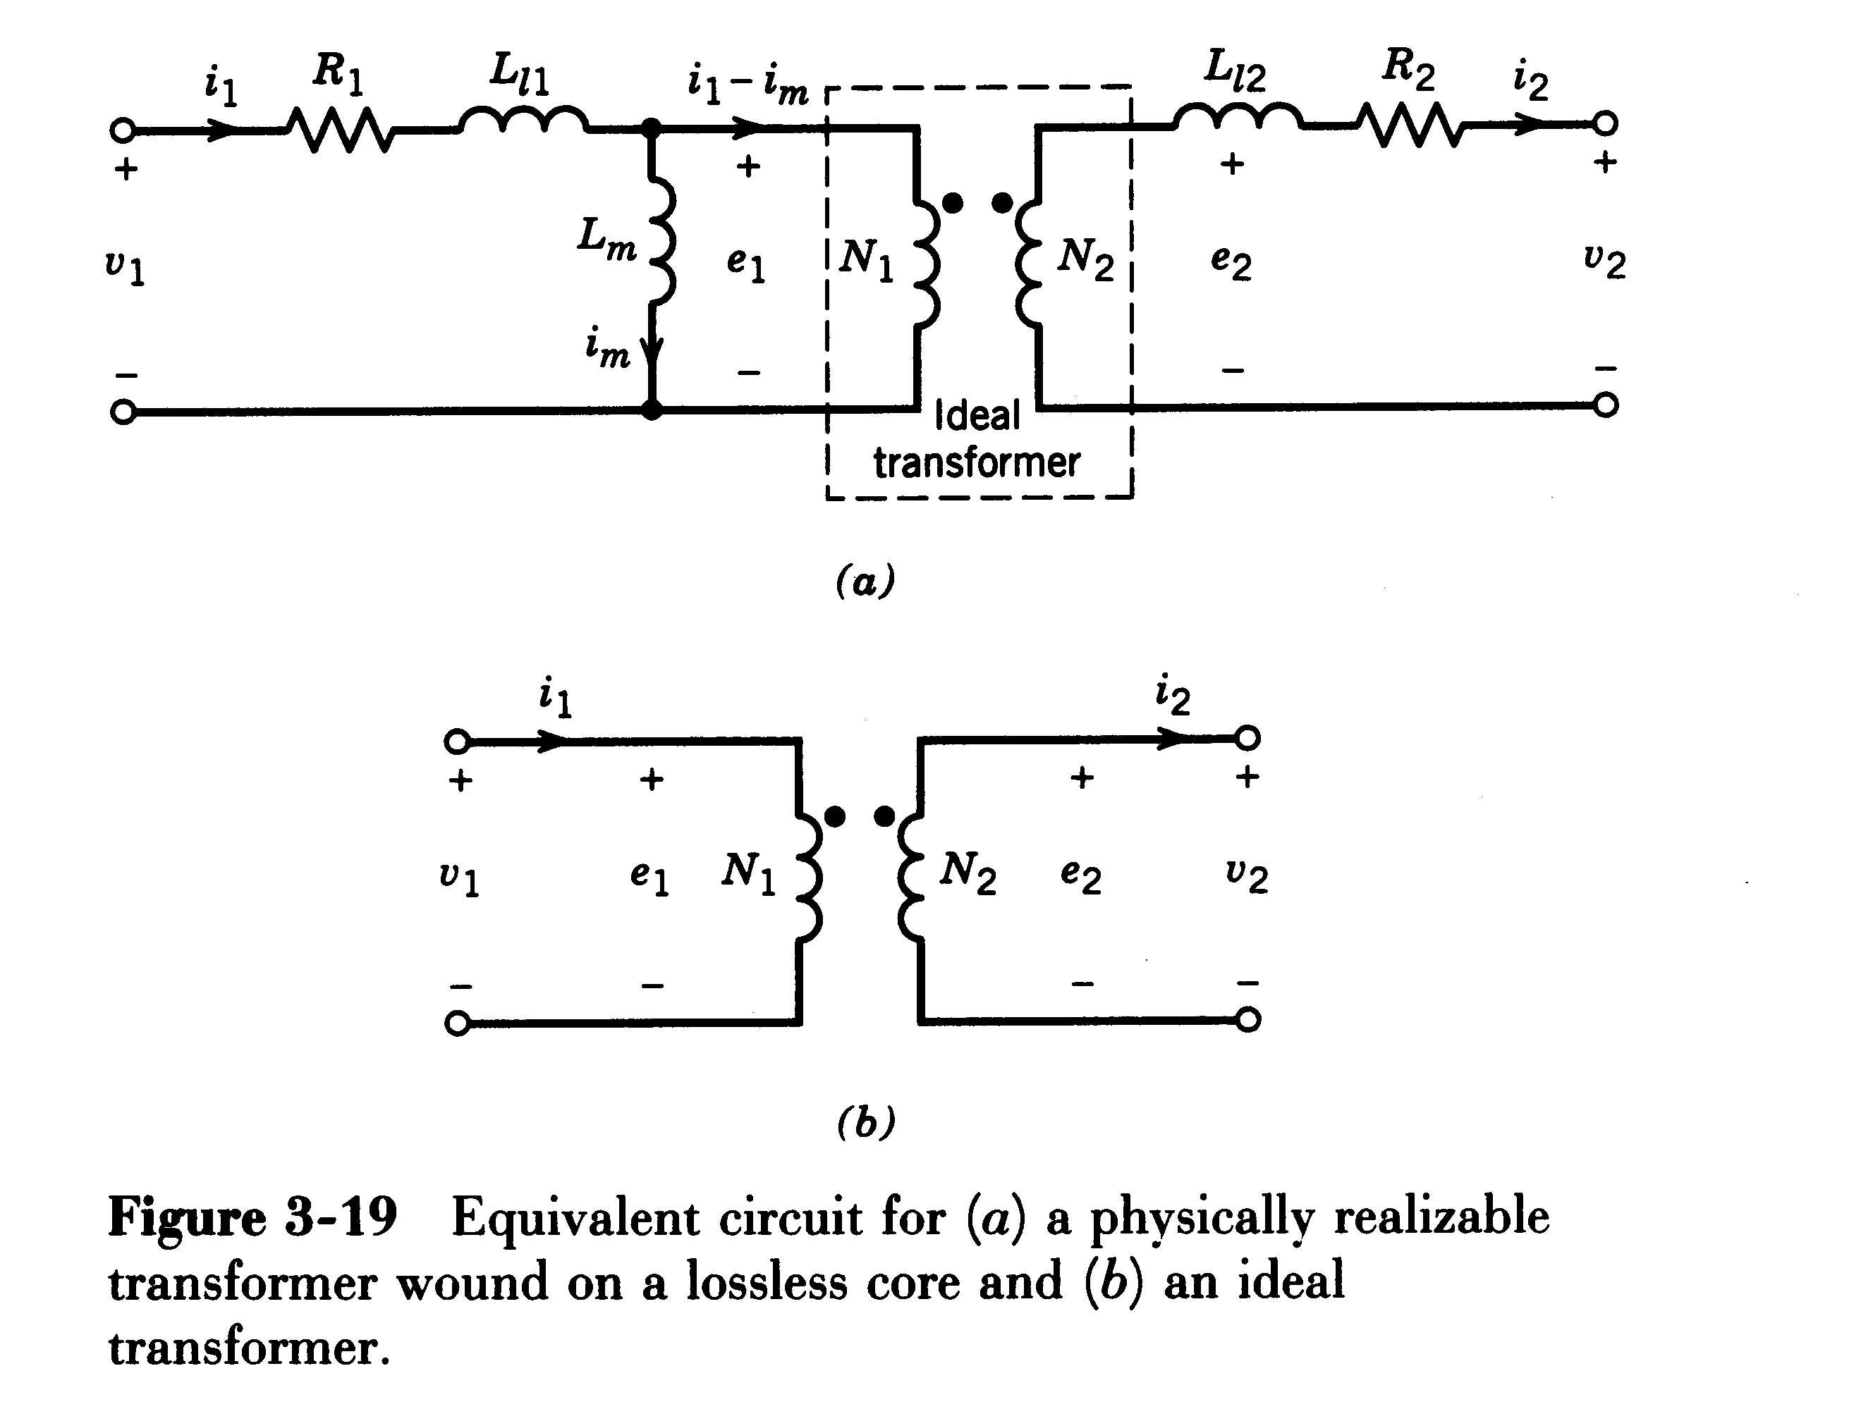
10-4-2 Flyback Converters
1 Converter Circuit
i₁
i₂
i_{d}
N₁:N₂
+
V_{o}
-
S
+
V_{d}
-
D
C
R
+
V_{d}
-
+
v_{L}
-
i_{L}
-
V_{o}
+
R
L
T
Two-winding inductor
i_{o}
Buck-Boost converter
Flyback converter

Slide 42
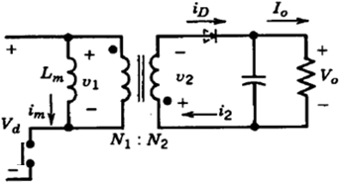
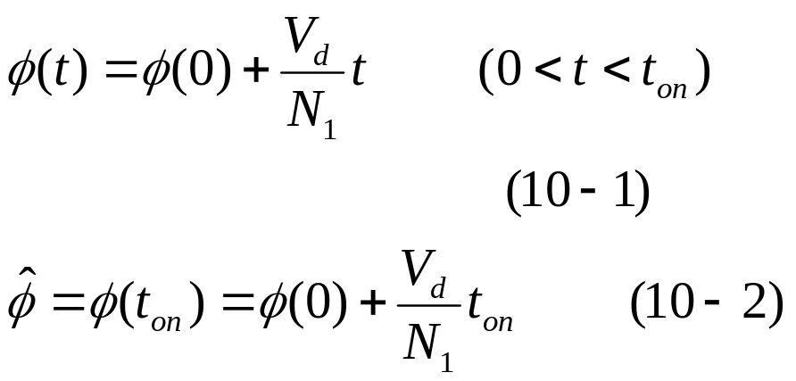
i₁
i₂
N₁:N₂
-
v₂
+
+
V_{o}
-
+
V_{d}
-
+
v₁
-
D
C
R
2 Operation principle
(1) During the t_{on} period:
Turning on the transistor at t=0,
v₁=V_{d}, V₂=(N₂/N₁)V_{d}.The diode D becomes reverse biased. The inductor core flux Φ increases linearly from its initial value Φ(0).
T
v₁
V_{d}
t
t_{on}
t_{off}
-(N₁/N₂)V_{o}
Φ
Φ(0)
t
i_{D}
I_{o}
t

Slide 43
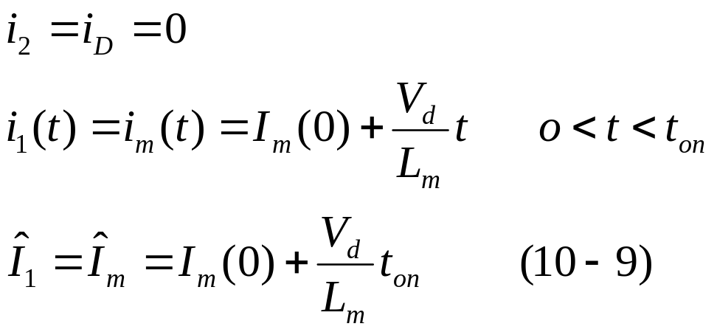
i₁
i₂
N₁:N₂
-
v₂
+
+
V_{o}
-
+
V_{d}
-
+
v₁
-
D
C
R
2 Operation principle
During the t_{on} period:
The output load is entirely supplied by the energy stored in the output capacitor.
T
v₁
V_{d}
t
t_{on}
t_{off}
-(N₁/N₂)V_{o}
Φ im(t)
Φ(0) Im(0)
t
i_{D}
I_{o}
t

Slide 44


i₁
i₂
N₁:N₂
-
v₂
+
+
V_{o}
-
+
V_{d}
-
+
v₁
-
D
C
R
(2) During the t_{off} period:
At t=t_{on}, turning off the transistor:
v₂=-V_{o}, V₁=-(N₁/N₂)V_{o}, forcing the input current to zero. Due to Φ cannot change instantaneously, i₂ suddenly jumps to its peak value. During the t_{off}, Φ declines linearly.
T
v₁
V_{d}
t
t_{on}
t_{off}
-(N₁/N₂)V_{o}
Φ im(t)
Φ(0) Im(0)
t
i_{D}
I_{o}
t

Slide 45

i₁
i₂
N₁:N₂
-
v₂
+
+
V_{o}
-
+
V_{d}
-
+
v₁
-
D
C
R
During the t_{off} period:
The output load is entirely supplied by the energy stored in the transformer.
T
v₁
V_{d}
t
t_{on}
t_{off}
-(N₁/N₂)V_{o}
Φ im(t)
Φ(0) Im(0)
t
i_{D}
I_{o}
t

Slide 46

i₁
i₂
N₁:N₂
-
v₂
+
+
V_{o}
-
+
V_{d}
-
+
v₁
-
D
C
R
In the continuous-conduction mode
T
Eq. 10-7 shows the dependence of the voltage-ratio on the duty-ratio D is identical to that in the Buck-Boost converter.
v₁
V_{d}
t
The flyback transformer is actually a two-winding inductor, which stores and transfers energy.
t_{on}
t_{off}
-(N₁/N₂)V_{o}
Φ im(t)
Φ(0) Im(0)
t
i_{D}
I_{o}
t

Slide 47

i₁
i₂
N₁:N₂
-
v₂
+
+
V_{o}
-
+
V_{d}
-
+
v₁
-
D
C
R
T
v₁
V_{d}
t
t_{on}
t_{off}
-(N₁/N₂)V_{o}
Φ im(t)
Application:
Low Power Level below 50W.
Φ(0) Im(0)
t
i_{D}
I_{o}
t

Slide 48
10-4-2 Flyback Converters
3 Waveforms in different operating modes
v₁
v₁
v₁
V_{d}
t
V_{d}
V_{d}
0
N
1
0
N
1
U
0
N
1
N
U
N
o
N
U
t_{on}
t
2
o
t_{off}
t_{on}
2
t_{off}
t_{on}
2
o
m
t_{off}
T_{s}
T_{s}
T_{s}
v_{T}
v_{T}
v_{T}
U
+
N
1
U
+
N
1
U
U
+
N
1
U
N
U
d
N
2
o
d
N
o
d
2
o
U
d
2
0
0
0
i₁
i₁
I_{1max}
i₁
I_{1max}
U
I_{1max}
U
d
t
d
L
L
t
1
1
0
0
i₂
I_{2max}
i₂
I_{2max}
i₂
I_{2max}
I
−
U
t
I
2max
−
U
o
t
2max
o
L
L
2
2
0
0
a) discontinuous-conduction mode
b) Boundary between continuous and discontinuous conduction
c) continuous-conduction mode

Slide 49

10-4-2 Flyback Converters
PSpice Modeling: C:\FirstCourse_PE_Book03\flyback.sch

Slide 50

10-4-2 Flyback Converters
Simulation Results

Slide 51

10-4-2 Flyback Converters
4 An practical FlyBack dc-dc supply

Slide 52

10-4-2 Flyback Converters
5 Other Flyback Converter Topologies
vs Full bridge converter
Not commonly used

Slide 53
10-4-3 Forward Converters
10-4-3 Forward Converters
An idealized forward converter
This is essentially a Buck + Transformer inserted.
D₁
L
i_{L}
A
N₁:N₂
L
+
V_{d}
-
+ v_{L} -
+
V_{o}
-
R
+
V_{d}
-
+
V_{o}
-
D₂
R
T
B
Buck Converter
Forward Converter

Slide 54

10-4-3 Forward Converters
An idealized forward converter
Operation principle
Initially, assuming a transformer to be ideal. (Transformer magnetizing current i_{m}=0)
(1) When the switch T is on, D₁ becomes forward biased and D₂ reverse biased. Therefore,
D₁
L
i_{L}
N₁:N₂
+
V_{d}
-
+ v_{L} -
+
V_{o}
-
R
i_{L} increase linearly.
D₂
T

Slide 55


10-4-3 Forward Converters
(2) When the switch T is turned off, i_{L} circulates through D₂, and
D₁
L
i_{L}
N₁:N₂
+
V_{d}
-
+ v_{L} -
+
V_{o}
-
R
i_{L} decrease linearly.
D₂
T
In the condition of steady-state:
Identical to that in the Buck converter.

Slide 56


10-4-3 Forward Converters
In a practical forward converter, the transformer magnetizing current i_{m} must be taken into consider. Otherwise, the stored energy in the transformer core would result in converter failure.
T
D₁
L
i_{L}
N₁:N₂
v_{N1}
+
V_{d}
-
+ v_{L} -
+
V_{o}
-
R
D₂
T
i_{m}

Slide 57
10-4-3 Forward Converters
→ ☆ we must provide a path for magnetizing current i_{m} until core “resets”（磁通复位） to zero flux each cycle. Otherwise, i_{m}, B_{s} will “run away” over time and saturate the core.
T
B
t
t_{on}
t_{rst}
B
v_{N1}
S
t
B
i_{m}
R
O
t
H

Slide 58
10-4-3 Forward Converters
A practical forward converter
Winding N₃--demagnetizing windings（去磁绕组）
An approach that allows the transformer magnetic energy to be fed back to the input supply.
D₁
L
i_{L}
i₂
+ v_{L} -
+
V_{o}
-
+
V_{d}
-
N₁
N₃
N₂
D₂
i₁
i₃
T
D₃
Practical forward converter

Slide 59

10-4-3 Forward Converters
i₂
D₁
L
i_{L}
v₁
+
V_{d}
-
+ v_{L} -
+
V_{o}
-
V
N₁
N₃
N₂
D₂
d
t
0
−
N
V_{d}
N
1
3
i₁
i₃
t
t
m
on
t
off
T
D₃
Practical forward converter
T
S
v_{T}
V_{d}
+
N
1
V_{d}
V_{d}
N
3
0
t
v_{D2}
N
V_{o}
2
V_{d}
0
N
1
t
i₁
Operation principle
0
t
(1) During t_{on} period (0<t<t_{on}): D₁ forward biased and D₂ and D₃ reverse biased. Therefore, i_{m} and i_{L} increase linearly.
i_{m}
0
t
i_{L}
0
t

Slide 60


10-4-3 Forward Converters
D₁
L
i_{L}
i₂
v₁
+ v_{L} -
+
V_{o}
-
V
d
+
V_{d}
-
0
t
N₁
N₃
N₂
D₂
−
N
1
V_{d}
N
3
t
t
m
i₁
i₃
on
t
off
T
S
T
D₃
Practical forward converter
v_{T}
V_{d}
+
N
1
V_{d}
V_{d}
N
3
0
t
v_{D2}
N
V_{o}
2
V_{d}
0
N
1
t
i₁
0
t
i_{m}
0
t
i_{L}
0
t

Slide 61

10-4-3 Forward Converters
(2) During t_{m} period (t_{on}<t<t_{on}+t_{m}): D₁ reverse biased, D₂ and D₃ forward biased, and i_{m} and i_{L} decrease linearly.
v₁
V
d
0
t
−
N
1
V_{d}
N
3
t
t
m
on
t
off
N₁:N₂
D₁
L
i_{L}
T
S
v_{T}
+
V_{d}
-
+ v_{L} -
+
V_{o}
-
R
D₂
V_{d}
+
N
1
V_{d}
N
3
V_{d}
0
t
T
v_{D2}
N
V_{o}
2
V_{d}
0
N
1
t
i₁
0
t
i_{m}
0
t
i_{L}
0
t

Slide 62



10-4-3 Forward Converters
v₁
V
d
0
t
−
N
1
V_{d}
N
3
t
t
m
on
t
off
T
S
v_{T}
☆ To avoid the core from saturating, t_{mmax} must less than (1-D)T_{s}.
V_{d}
+
N
1
V_{d}
V_{d}
N
3
0
t
v_{D2}
N
V_{o}
2
V_{d}
0
N
1
t
i₁
0
t
i_{m}
☆ Typically, N₃=N₁. therefore D_{max}=0.5
0
t
i_{L}
0
t

Slide 63

10-4-3 Forward Converters
What happens when D >0.5 ？
i_{M} will “run away” over time and saturate the core.

Slide 64


10-4-3 Forward Converters
(3) After t_{on}+t_{m} (t_{on}+t_{m}<t<T_{s}): i_{m}=i_{T}=0, D₁, D₃ off, i_{L} flows through D₂, and i_{L} decrease linearly.
v₁
V
d
0
t
−
N
1
V_{d}
N
3
t
t
m
on
t
off
T
S
v_{T}
V_{d}
+
N
1
V_{d}
V_{d}
N
3
0
t
v_{D2}
N
V_{o}
2
V_{d}
0
N
1
t
i₁
0
t
i_{m}
0
t
i_{L}
0
t

Slide 65

10-4-3 Forward Converters
v₁
In the continuous-conduction mode
V
d
0
t
−
N
1
V_{d}
N
3
t
t
m
on
t
off
T
S
v_{T}
Eq. 10-16 shows the dependence of the voltage-ratio on the duty-ratio D is identical to that in the Buck converter.
V_{d}
+
N
1
V_{d}
V_{d}
N
3
0
t
v_{D2}
N
V_{o}
2
V_{d}
0
N
1
t
i₁
☆ Note: In the forward converter, the transformer magnetizing inductance operates in the dis-continuous conduction mode.
0
t
i_{m}
0
t
i_{L}
0
t

Slide 66

10-4-3 Forward Converters
D₁
L
i_{L}
v₁
i₂
+ v_{L} -
+
V_{o}
-
V
d
+
V_{d}
-
0
t
N₁
N₃
N₂
D₂
−
N
1
V_{d}
N
3
t
t
m
on
t
off
i₁
i₃
T
v_{T}
S
T
D₃
V_{d}
+
N
1
V_{d}
V_{d}
N
3
0
t
v_{D2}
N
V_{o}
2
V_{d}
0
N
1
t
i₁
0
t
i_{m}
0
t
i_{L}
0
t

Slide 67
10-4-3 Forward Converters
Voltage transfer ratio
The voltage conversion ratio of Forward converters operating in CCM depends on D, but is independent of the output load. If the output load decreases to the extent that i_{L} becomes discontinuous (DCM), the relationship (10-16) is no longer valid.

Slide 68

10-4-3 Forward Converters
PSpice Modeling: C:\FirstCourse_PE_Book03\forward.sch

Slide 69

10-4-3 Forward Converters
Simulation Results
i₁
i₃

Slide 70

10-4-3 Forward Converters
2 An practical Forward dc-dc supply

Slide 71

10-4-3 Forward Converters
3 Two-Switch Forward Converters
Eliminating the need for a separate demagnetizing winding and are used in much high power rating of a kW and even higher.

Slide 72
10-4-3 Forward Converters
Example 10-B Assume you are asked to design a photovoltaic (PV) based power supply to power on 12V DC loads. The power supply shall be able to out constant 12V when PV’s voltage is changing between 2V to 44.4V.
If a Forward converter is used,
(a) What is the maximum turns ratio of N₁:N₂?
(b) At this turns ratio, what is the duty ratio range of the converter?
(c) Based on (a), having V _{o} = 12V (constant) and R=2 ohm, calculate the minimum inductance of L that will guarantee continuous i _{L} , assuming 10 kHz switching.
(d) Based on (a), draw the switching status together with the voltage across Switch, V_{T} , for the cases 1) V _{d} =10 V and 2) V _{d} = 2 V.

Slide 73


10-4-3 Forward Converters
Solution
(a)
So the maximum turns ratio of N₁:N₂ is 1/12
(b)

Slide 74


10-4-3 Forward Converters
Solution
(c)
To guarantee continuous i_{L}, we have I_{L}>I_{ripple}

Slide 75

10-4-3 Forward Converters
Solution
(d) Consider N₃=N₁, so t_{m}=t_{on}

Slide 76
Summary of Flyback and Forward Converter
1 Common points
(a) Both are unidirectional core excitation, I_{m}>0
2 Difference
(a) Duty ratio
Flyback: 0≤D≤1
Forward: 0≤D≤0.5
(b) Transformer core design
Flyback: inductor
Forward: transformer

Slide 77

Supplement material
1 Understand the B-H curve
(a) From a to b, the H is increasing, which means the current goes through the inductor winding is increasing, energy is stored into the inductor.
(b) From b to c, the H is decreasing, which means the current goes through the inductor winding is decreasing, energy is released out of the inductor.
b
d
(c) The area abc is called hysteresis loss(磁滞损耗), which is directly proportional to applied frequency.
c
a

Slide 78


Supplement material
2 Transformer vs inductor
(a) For most transformer design, the goal is to pass the power through the transformer instantaneously, which means most transformers are not intended to be energy storage device.

Slide 79

Supplement material
(b) In most cases, inductor acts like a energy charge pump, it stores energy and release it to the circuit when energy is needed.
Inductor core B-H characteristic

